Slide 1
MongoDB
SQL and NoSQL Database
Installing MongoDB

Slide 2
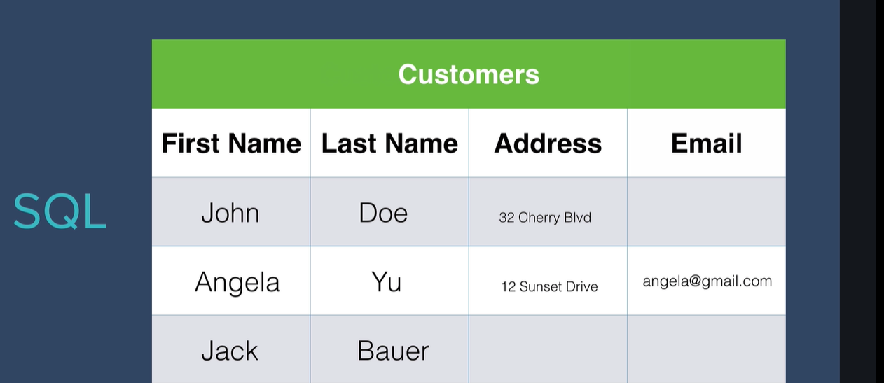
SQL Database

Slide 3
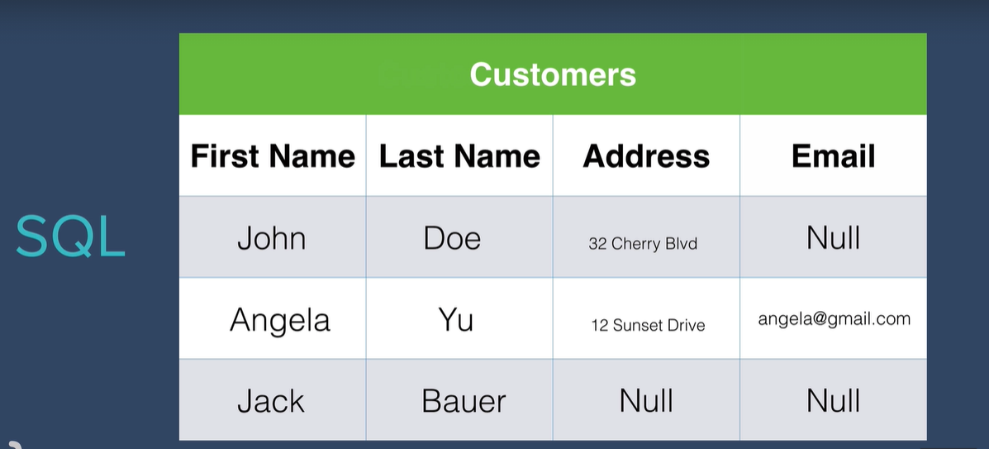
SQL Database

Slide 4
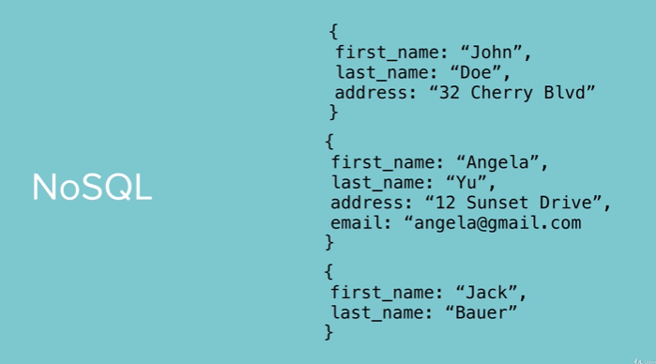
NOSQL Database

Slide 5
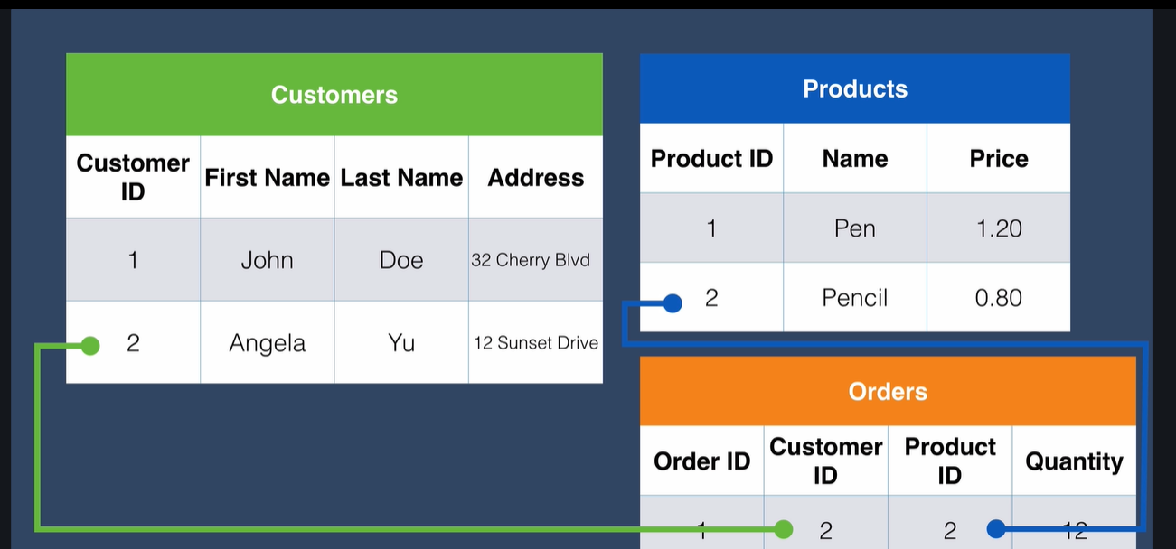
Relational Database

Slide 6
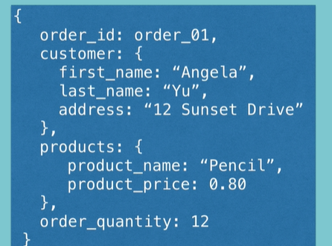
Relational Database

Slide 7
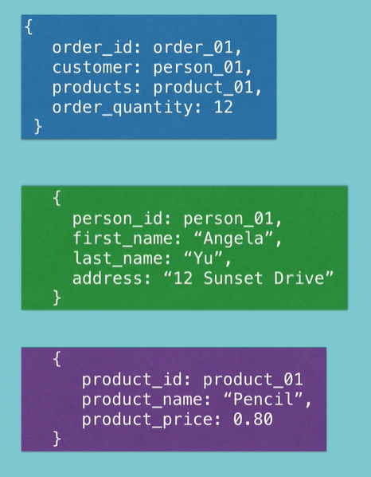
Relational Database

Slide 8
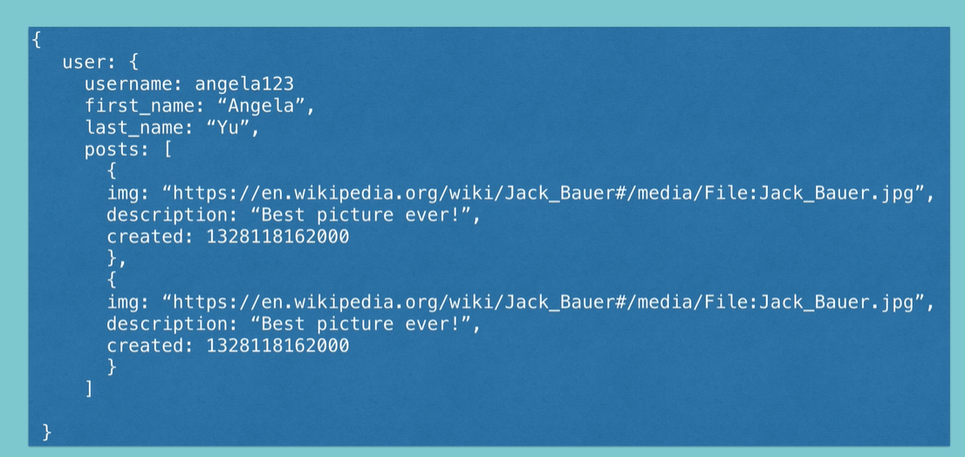
Document Database

Slide 9
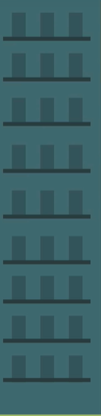
SQL - Scalability

Slide 10
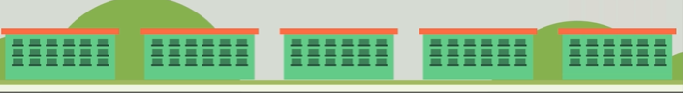
MongoDB - Scalability

Slide 11
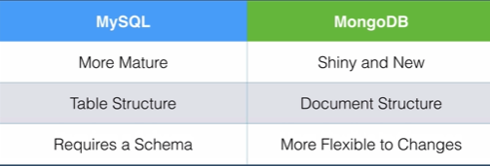
Comparison

Slide 12
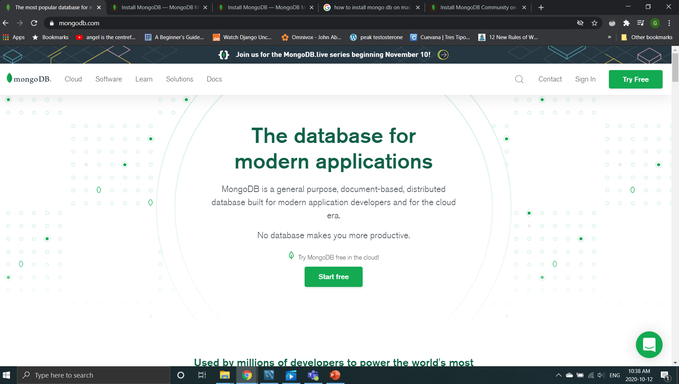
mongoDB Web site
https://www.mongodb.com/

Slide 13
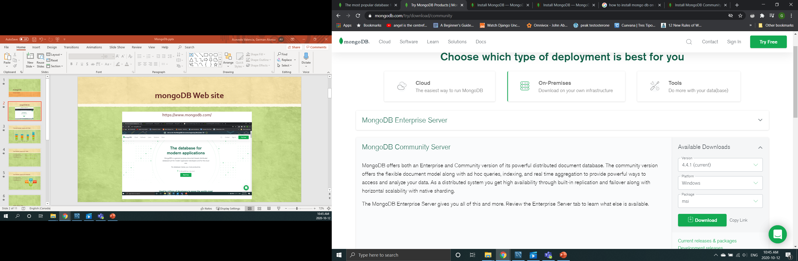
Step1 Downloading MongoDB
Choose platform
MongoDB community server
Download

Slide 14
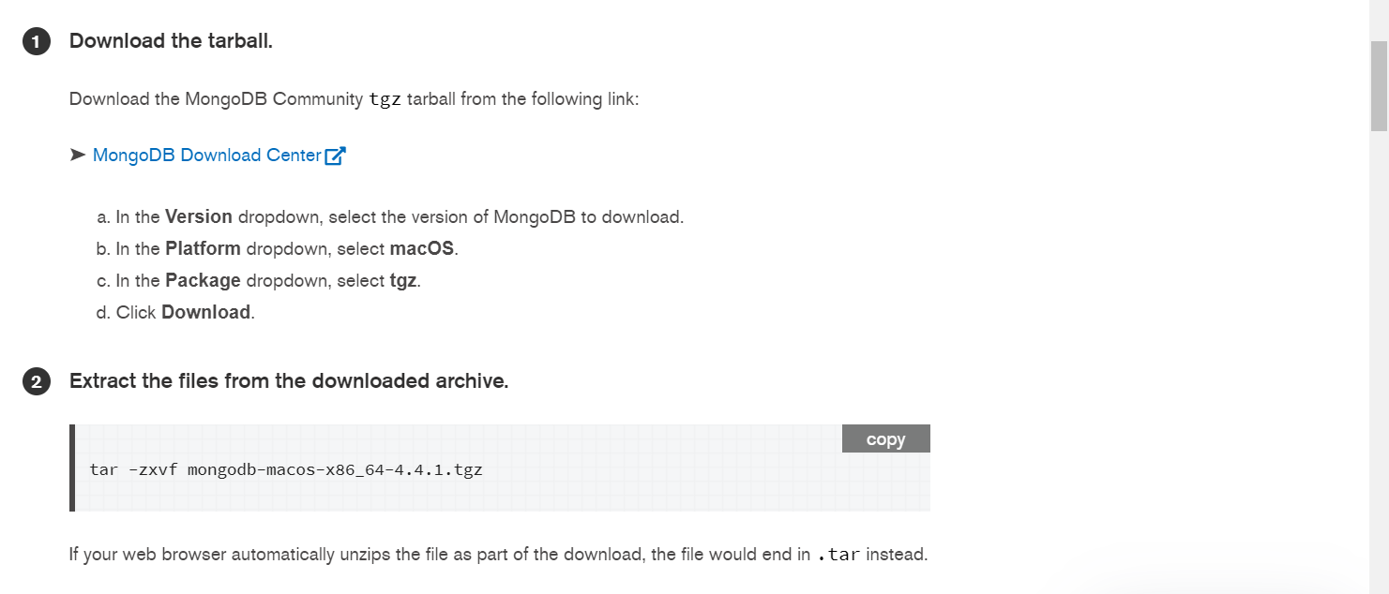
Installing MongoDB on Mac

Slide 15
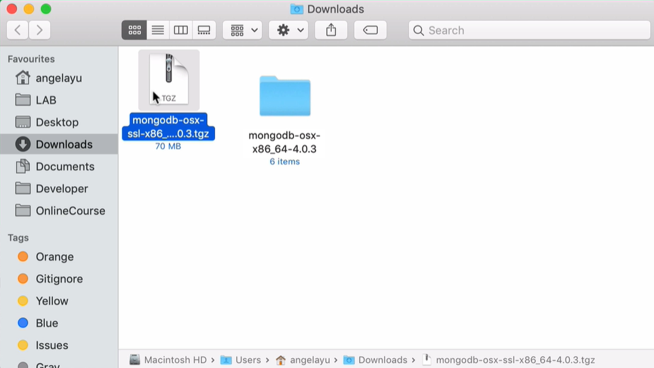
Step 2 Extract the Tarball
Allow us to use MongoDB on a local system
Doble click the compressed file
to extract it

Slide 16
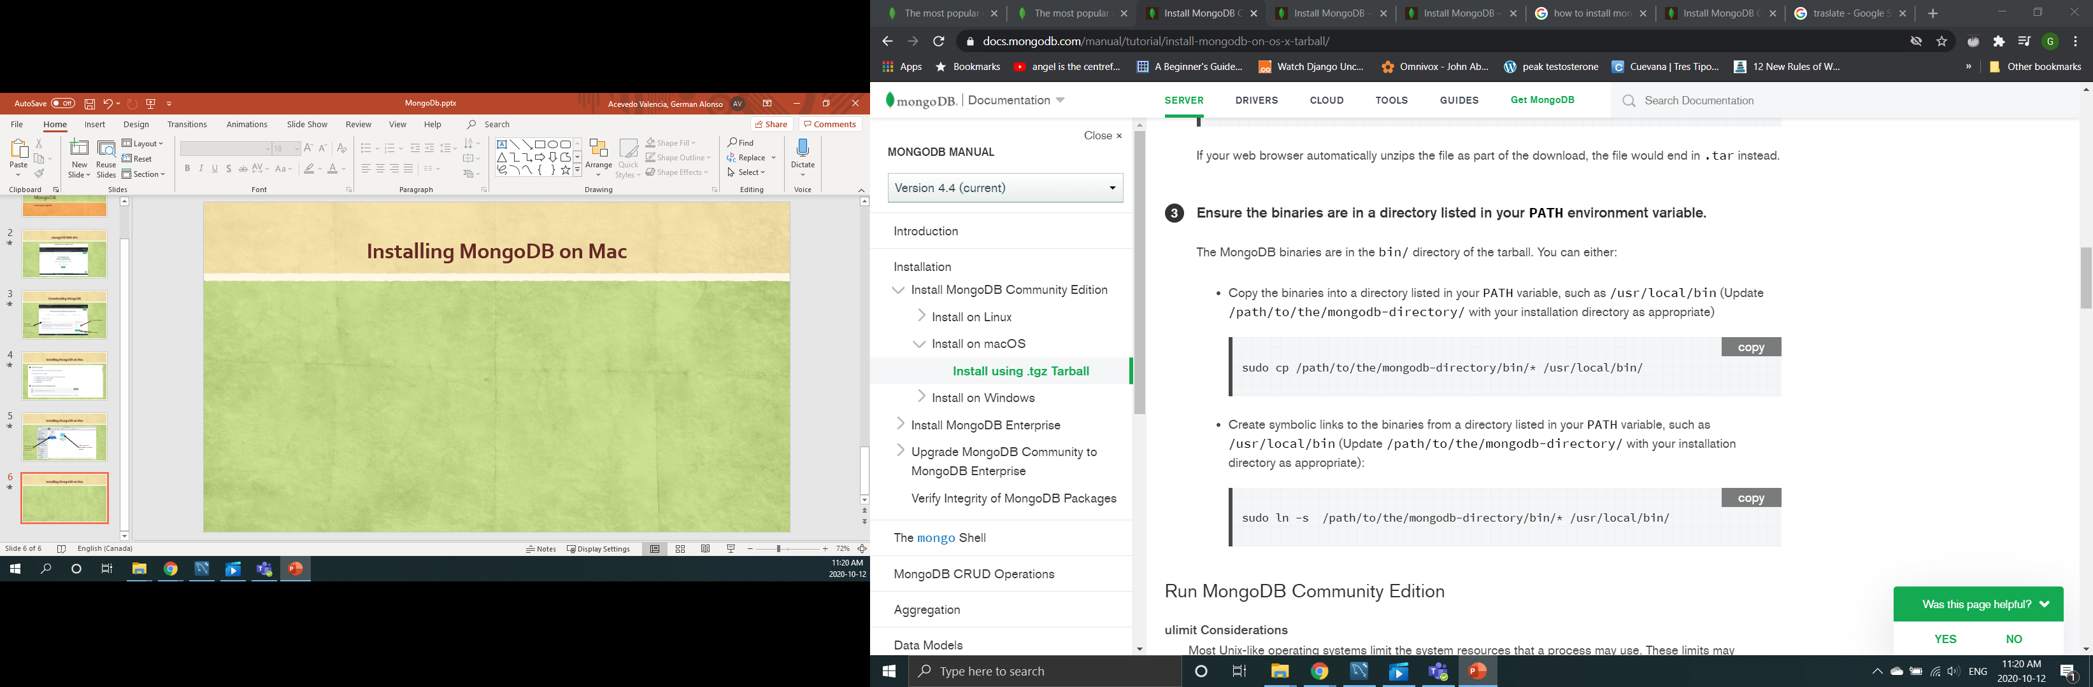
Step 3 Move the Binaries to the Local User

Slide 17
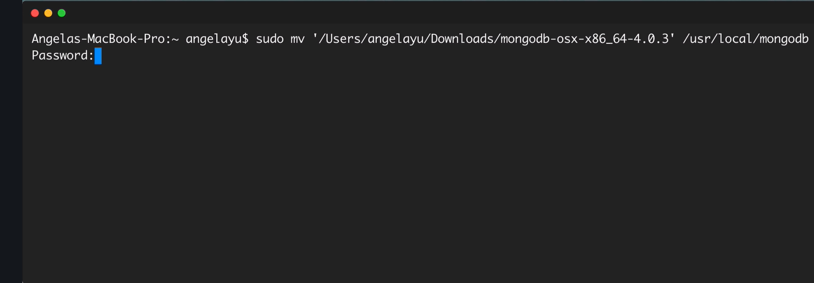
3. Move the Binaries to the Local User
3.1 Open the terminal
3.2. Type:
3.3 Click and dragged the actual location of your current MongoDb binary in your computer in order to get to that file.
3.4 Type this location to specify where we want to move it
3.5. Type the password that you normally use to log on to your Mac

Slide 18
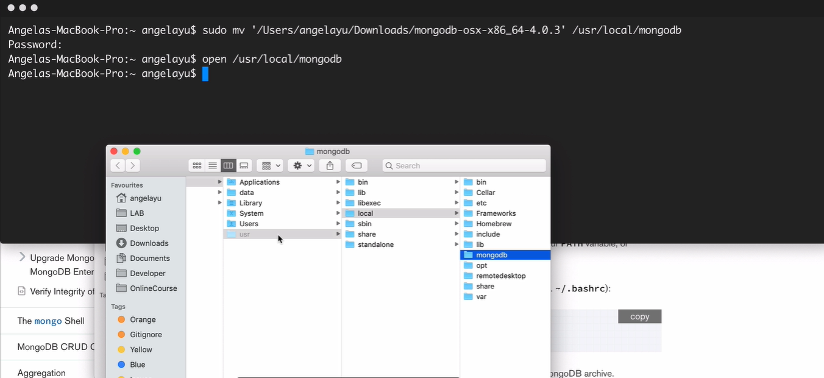
Confirm that the move was successful
3.6 We are going to type open/usr/local/mongodb just to verify that all those files have been moved into a folder mongodb.

Slide 19
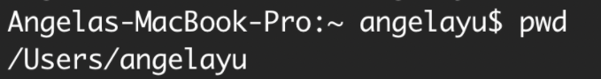
Step 4 Adding the MongoDB Binaries to Environment Variables
4.1 Change directory to your home folder with cd ~ and hit enter.
4.2 Check that you are inside User/username with the command pwd and hit enter (print working directory).
4.3 Create a bash profile with touch .bash_profile
4.4 Edit the new bash_profile with Vim. Using vim .bash_profile

Slide 20
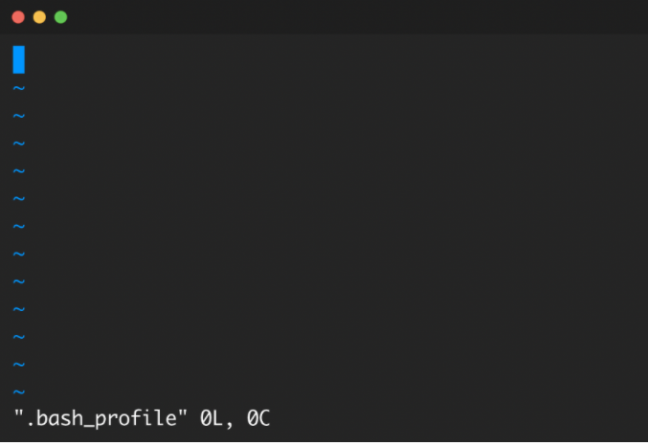
Step 4 Adding the MongoDB Binaries to Environment Variables
Once you hit enter, you should be inside the Vim editor..

Slide 21
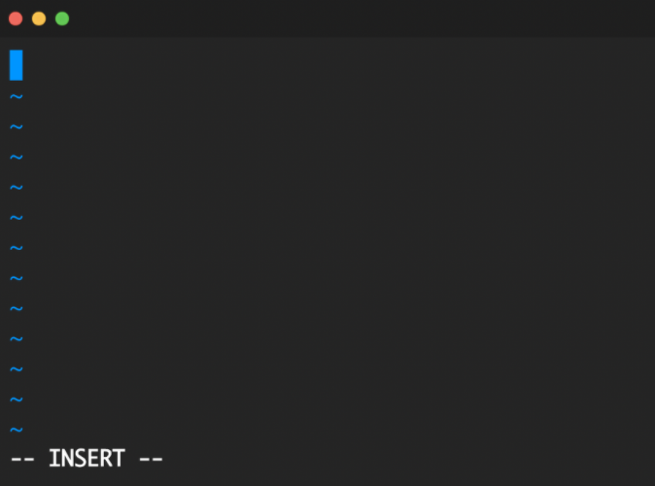
Step 4 Adding the MongoDB Binaries to Environment Variables
4.5 Hit the I key on the keyboard to enter Insert mode.

Slide 22
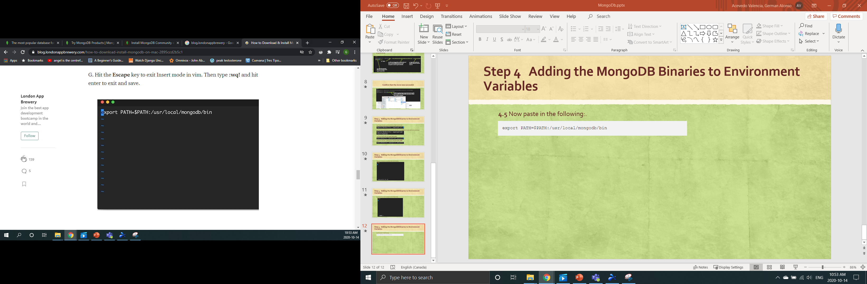
Step 4 Adding the MongoDB Binaries to Environment Variables
4.5 Now paste in the following:.

Slide 23
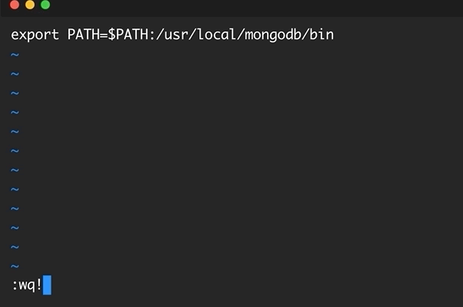
Step 4 Adding the MongoDB Binaries to Environment Variables
4.5 Hit the Escape key to exit Insert mode in vim. Then type :wq! and hit enter to exit and save.:.

Slide 24
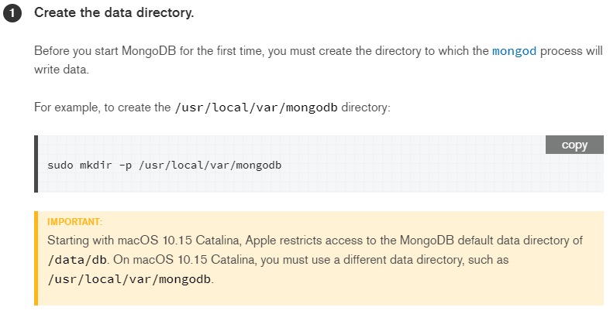
Step 5 Run MongoDB Community Edition

Slide 25
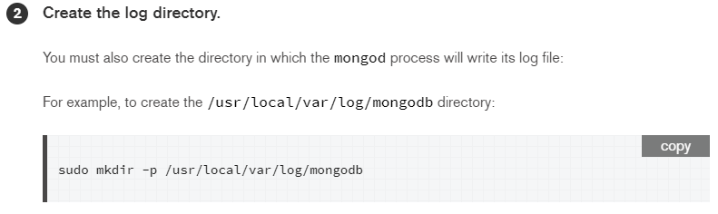
Step 5 Run MongoDB Community Edition
5.1 Create a folder called data and inside create another called db at the root of your computer with the following command:

Slide 26
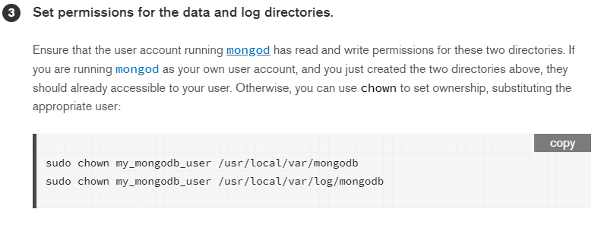
Step 5 Creating the Local Data Storage Location for MongoDB

Slide 27
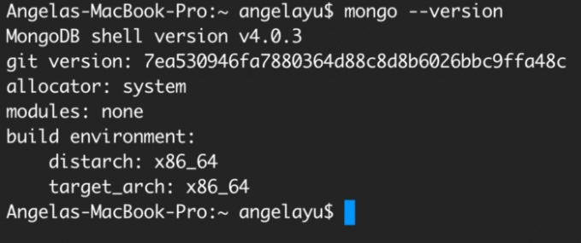
Step 6 Test it
5.1 Quit the Terminal and reopen it.
5.2 Type the following command after your prompt

Slide 28
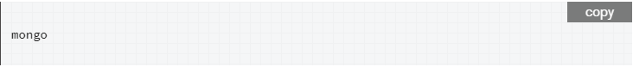
Step 7 Begin using MongoDB
You can run the mongo shell without any command-line options to a mongod that is running on your localhost with the default port of 27017.

Slide 29
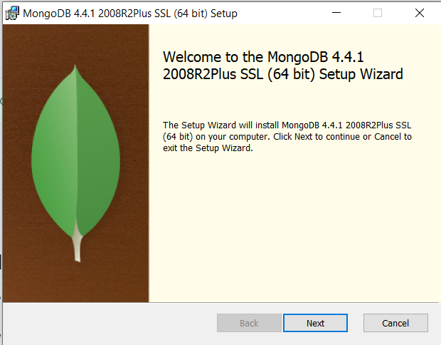
Installing MongoDB on Windows

Slide 30
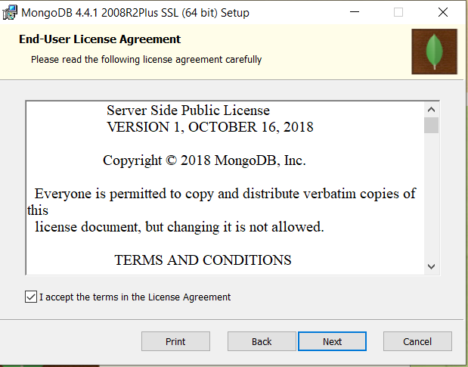
Installing MongoDB on Windows

Slide 31
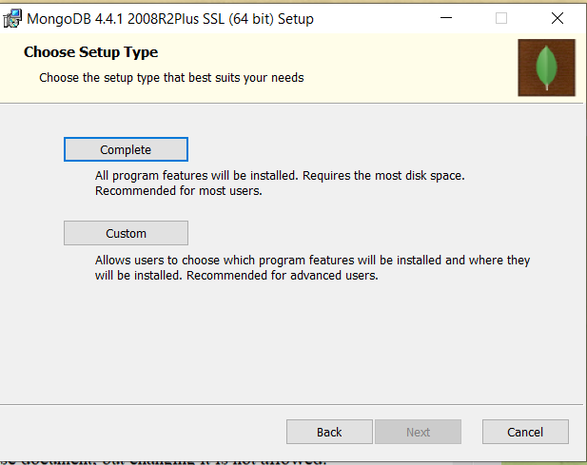
Installing MongoDB on Windows

Slide 32
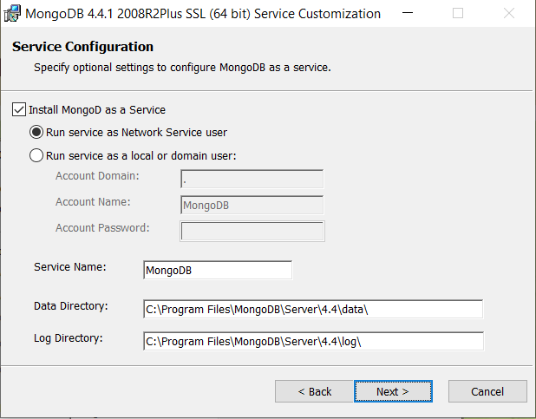
Installing MongoDB on Windows

Slide 33
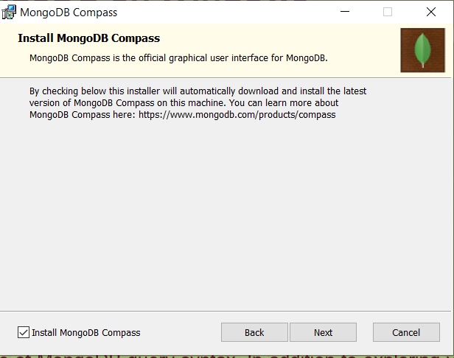
Installing MongoDB on Windows
MongoDB Compass is the GUI for MongoDB. Compass allows you to analyze and understand the contents of your data without formal knowledge of MongoDB query syntax. In addition to exploring your data in a visual environment, you can also use Compass to optimize query performance, manage indexes, and implement document validation.

Slide 34
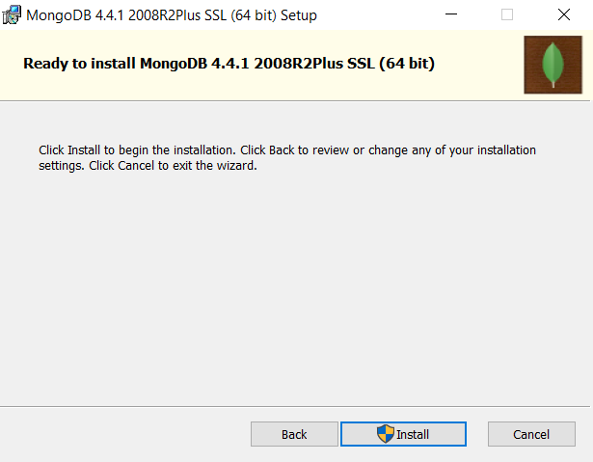
Installing MongoDB on Windows

Slide 35
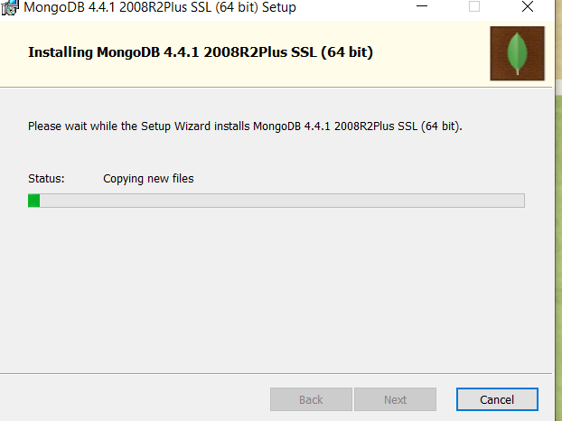
Installing MongoDB on Windows

Slide 36
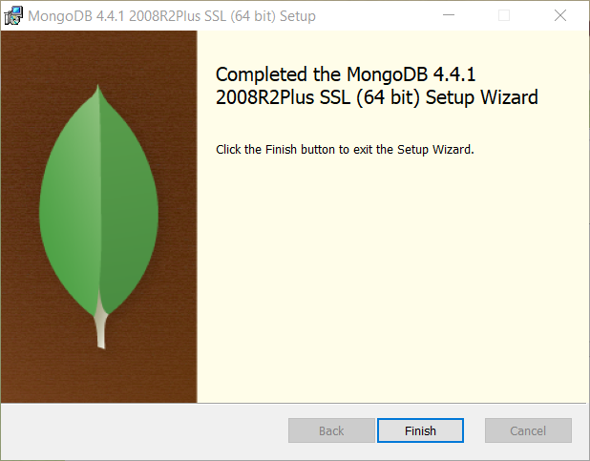
Installing MongoDB on Windows

Slide 37
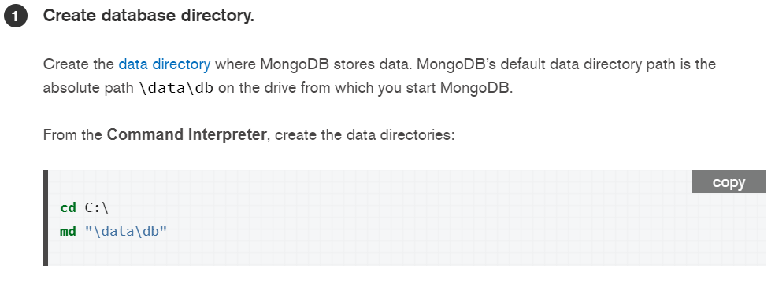
Installing MongoDB on Windows

Slide 38
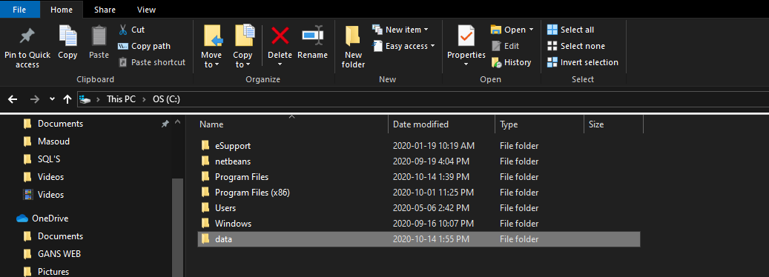
Installing MongoDB on Windows

Slide 39
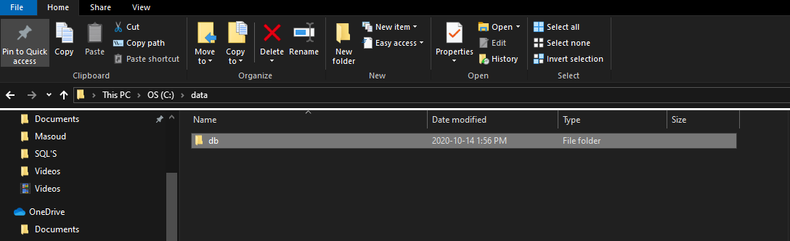
Installing MongoDB on Windows

Slide 40
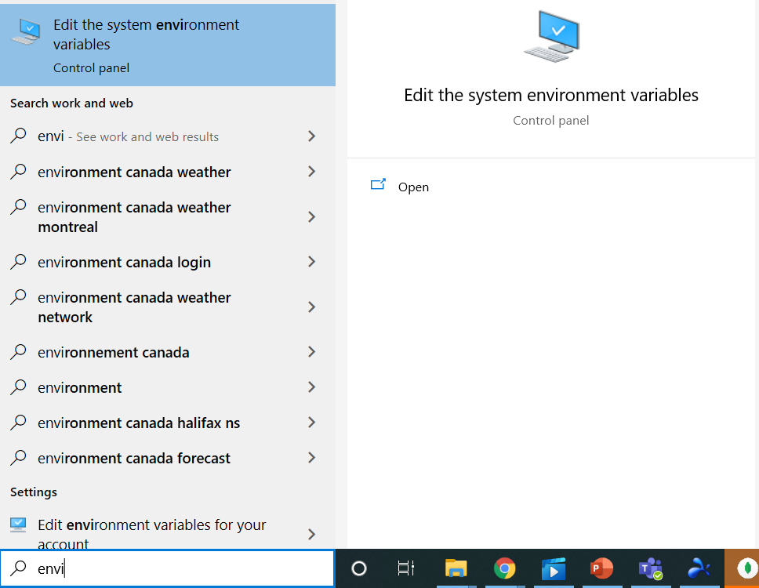
Installing MongoDB on Windows

Slide 41
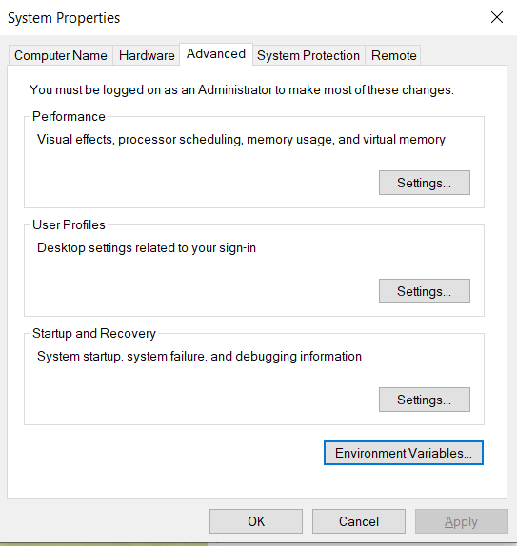
Installing MongoDB on Windows

Slide 42
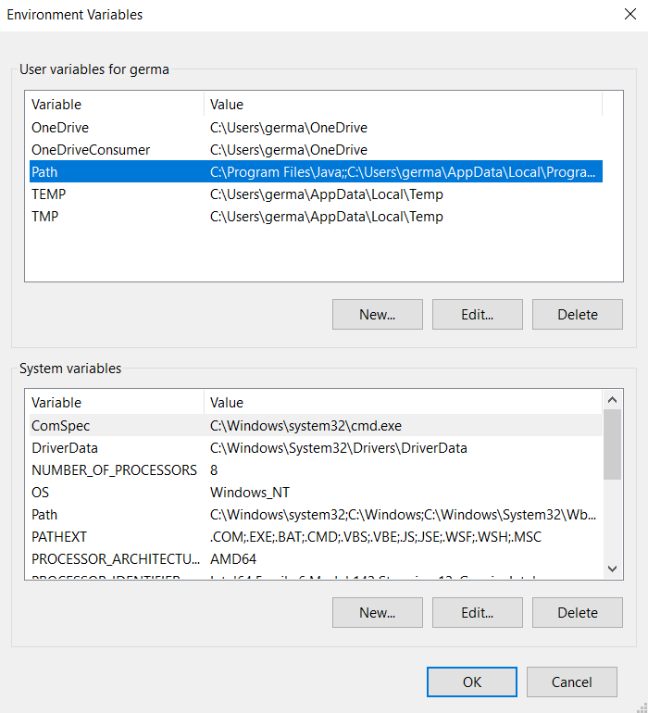
Installing MongoDB on Windows

Slide 43
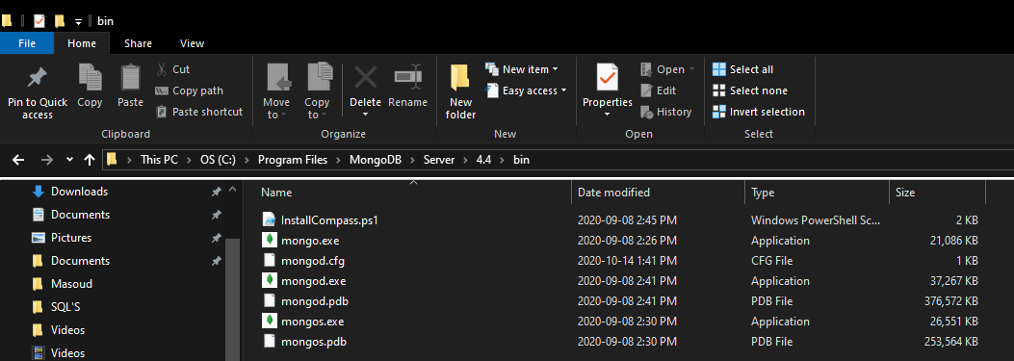
Installing MongoDB on Windows

Slide 44
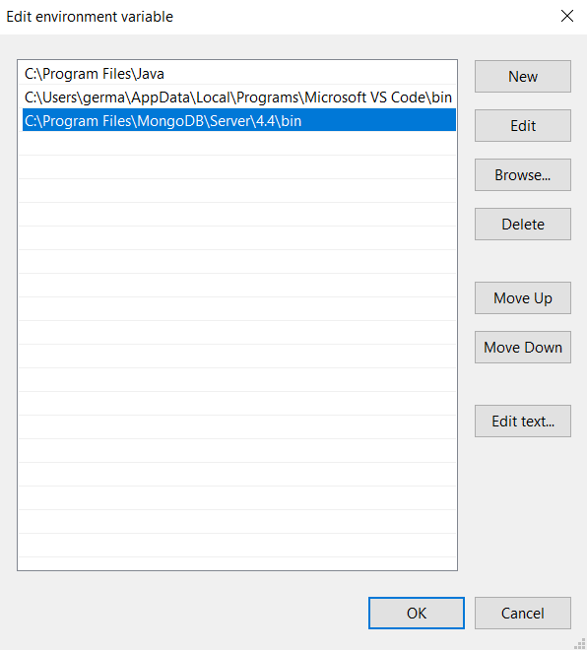
Installing MongoDB on Windows

Slide 45
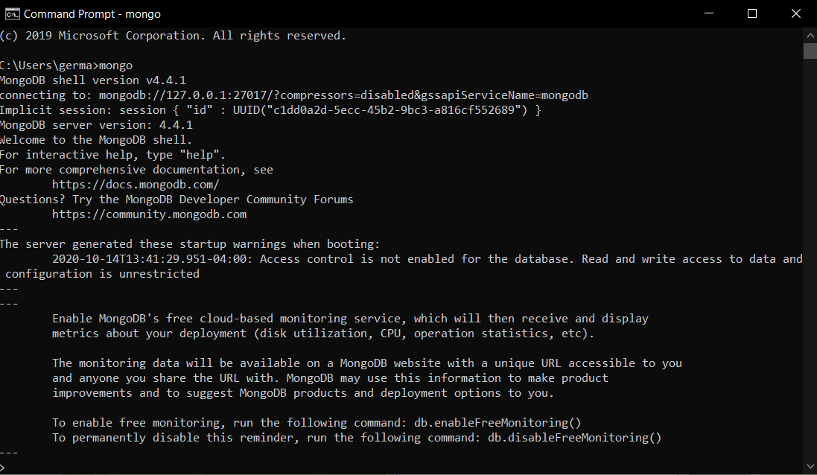
Installing MongoDB on Windows

